Slide 1
Capstone Project
Recreate classic arcade game
By Bartosz Markiewicz
Supervisor - Doctor, Faiyaz

Slide 2
The Project Subject
  To create a classic arcade game from the 80s
    Decided on a side-scrolling platformer
      Super Mario Bros 'clone'
      The goal is to get as much score as possible and reach the end of the level.
  To recreate the classic experience.
  A serious aspect - to educate people on the topic of migration. The travel and the dangers of it.
Source - B.M, Markiewicz, "Initial Report"

Slide 3
Summary of Research
The video game industry is the fastest growing software industry segment.
Games can have a real purpose other than entertainment.
Player engagement is important.
The experience needs to be rewarding.
It is hard to effectively measure the learning effectiveness of a game.
Sources - B.M, Markiewicz, "Project Research", “Connecting the serious topic to the game research”

Slide 4
Initial Project Goals
2D tile based side-scroller
2 game modes
Power ups
Online leaderboard system
Accessibility features - visually and physically impaired
With a real serious purpose - to raise awareness about the serious issue of human trafficking - explored in 2 ways
  Story line
  Educational 'mini-games'
For Windows and Android
Source - B.M, Markiewicz, "Initial Report"

Slide 5
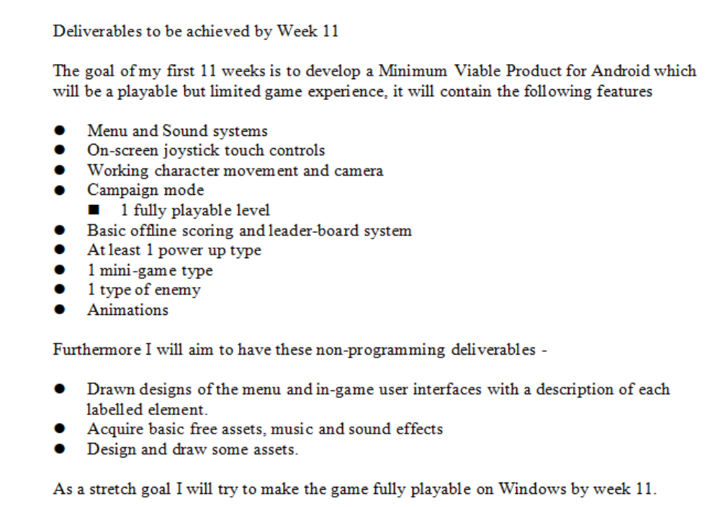
The Deliverables for Week 11
Source - B.M, Markiewicz, "Initial Report"

Slide 6
What I had acomplished?
All of the deliverables from the previous slide with some exceptions.
  leaderboard system
  Basic enemy
A fully playable Mario game.
Android and Windows versions working.
Assets

Slide 7
The Goals Now
2D tile based side-scroller
An online high-scores sytem.
Power ups
Simple RPG-game elements.
  NPC system
  Basic inventory system
  Non-linear level design
Serious topic changed to 'migration' in general instead of just human trafficking.
  Allegory of a journey of a migrant/traveller
For Windows and Android
Source - B.M, Markiewicz, “Connecting the Serious Topic to the game research
”

Slide 8
Demonstration

Slide 9
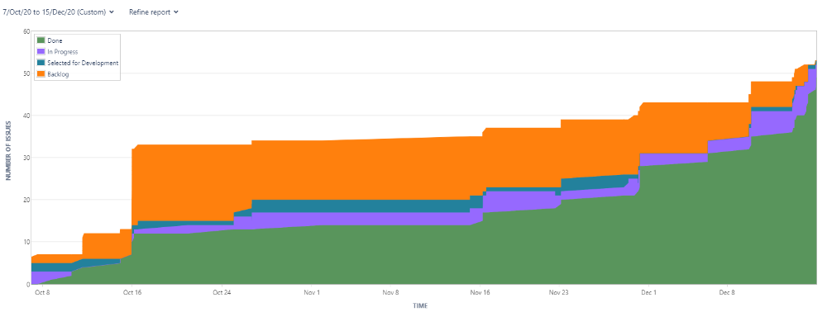
Cumulative Flow Diagram from Jira UPDATE THIS

Slide 10
Why //maybe remove this one
I enjoy game development.
I love the idea of developing a multi-platform application.

